Slide 1
JavaScript Basic
By: Manish Bharti
https://mcubeedu.in/

Slide 2
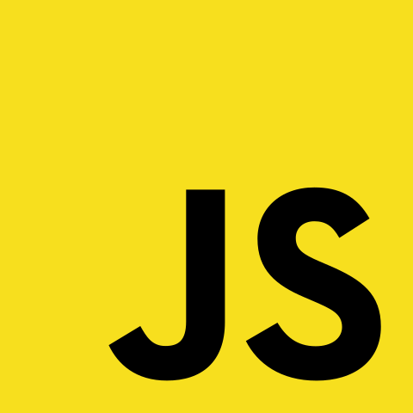
Agenda
What's JavaScript?
History
Applications and uses
JavaScript basic concepts
Code examples

Slide 3
What’s JavaScript?
High-level,
Dynamic, and
Interpreted
A programming language obviously.

Slide 4
History
Brendan Eich at Netscape Communications Corporation in 1995
To add dynamic functionality to static HTML pages
Many names: Mocha > LiveScript > JavaScript
1997 > ECMA(European Computer Manufacturers Association) > ECMAScript
2009 > Node.js > For server side
React and Angular > Front-end

Slide 5
Applications
web development,
desktop and mobile application development,
server-side programming,
game development, and more.
Famous websites:
Facebook, Twitter, Amazon, Google,
Node.js > Netflix, PayPal, LinkedIn, Walmart

Slide 6
JavaScript basics
variables,
data types,
operators,
expressions, and statements
if/else,
switch,
Loops
for,
while, and
do/while loops

Slide 7
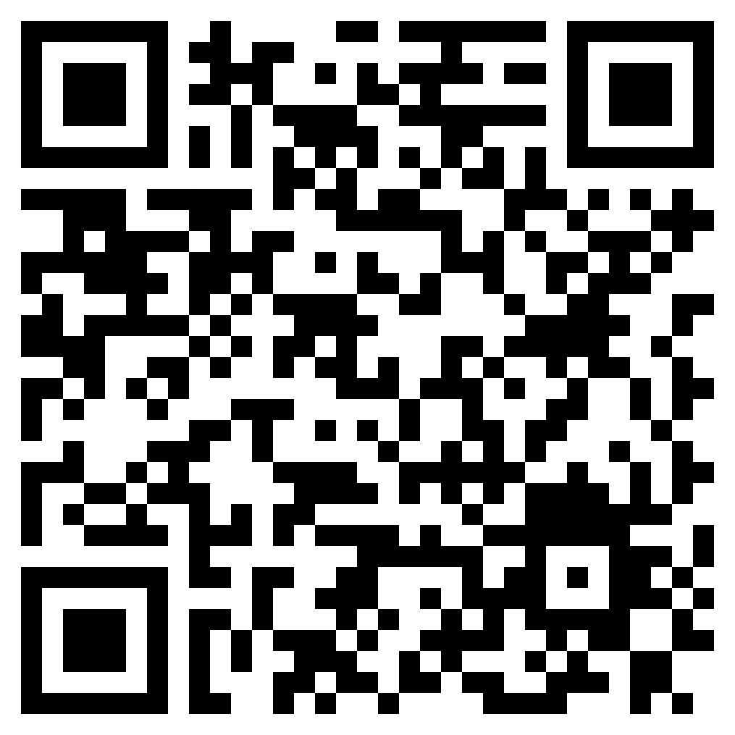
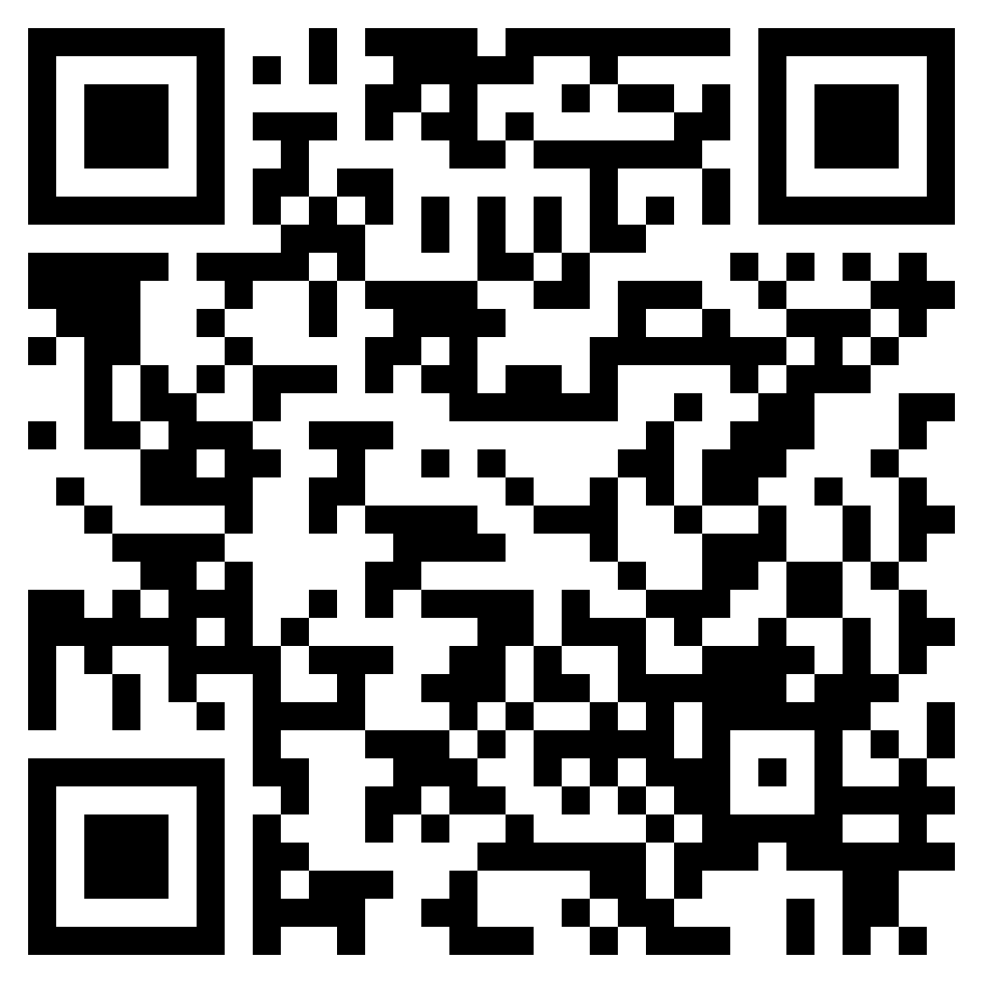
Code Example
https://github.com/mbharti321/javascript-code-examples
https://replit.com/@mbharti321/javascript-code-examples

Slide 8
Question?

Slide 9
console.log("Thanks,");
console.log("For being an amazing audience?");
console.log("100%, yes!");

